Slide 1
Matching
Network Algorithms 2005

Slide 2
Matching
Set of edges M ⊆ E such that no vertex is endpoint of more than one edge.
Maximal matching
  No e ∉E with M ∪ {e} also a matching
Maximum matching
  Matching with |M| as large as possible
Perfect matching
  |M| = n/2: each vertex endpoint of edge in M.

Slide 3
Cost versions
Each edge has cost; look for perfect matching with minimum cost

Slide 4
Problems
Given graph G, find
  Maximal matching: easy (greedy algorithm)
  Maximum matching
    Polynomial time; not easy.
    Important easier case: bipartite graphs
  Perfect matching
    Special case of maximum matching
    A theorem for regular bipartite graphs and Schrijvers algorithm

Slide 5
Applications
Personnel assignment
  Tasks and competences
Classroom assignment
Scheduling
Opponents selection for sport competitions

Slide 6
Application: matching moving objects
Moving objects, seen at two successive time moments
Which object came from where?

Slide 7
Bipartite graphs: using maximum flow algorithms
Finding maximum matching in bipartite graphs:
  Model as flow problem, and solve it: make sure algorithm finds integral flow.
Capacities 1
s
t

Slide 8
Technique works for variants too
Minimum cost perfect matching in bipartite graphs
  Model as mincost flow problem
b-matchings in bipartite graphs
  Function b: V → N.
  Look for set of edges M, with each v endpoint of exactly b(v) edges in M.

Slide 9
A simple non-constructive proof of a well known theorem
Let G be a regular bipartite graph with each vertex degree d. Then G has a perfect matching.
  Construct flow model of G. Set flow of edges from s, or to t to 1, and other edges flow to 1/d.
  Ford-Fulkerson will find flow of value n/2; which corresponds to perfect matching.

Slide 10
What does Ford-Fulkerson on the bipartite graph
M-augmenting path:
unmatched
becomes
in a flow augmentation step

Slide 11
A theorem that also works when the graph is not bipartite
Let M be a matching in graph G. M is a maximum matching, if and only if there is no M-augmenting path.
  If there is an M-augmenting path, then M is not a maximum matching.
  Suppose M is not a maximum matching. Let N be a larger matching. Look at N*M = N ∪ M – N ∩ M.
    Every node in N*M has degree 0, 1, 2: collection of paths and cycles. All cycles alternatingly have edge from N and from M.
    There must be a path in N*M with more edges from N than from M: this is an augmenting path.

Slide 12
Definitions
M-alternating walk:
  (Possibly not simple) path with edges alternatingly in M, and not M.
M-flower
  M-alternating walk that starts in an unmatched vertex, and ends as:
M-blossom

Slide 13
Finding an M-augmenting path or an M-flower – I
Let X be the set of unmatched vertices.
Let Y be the set of vertices with an edge not in M to a vertex in X.
Build digraph D = (V,A) with A = { (u,v) | there is an x with {u,x} in E-M and {x,v} in M}.
Find a shortest walk P from a vertex in X to a vertex in Y of length at least 1. (BFS in D.)
Take P’: P, followed by an edge to X.
P’ is M-alternating walk between two unmatched vertices.

Slide 14
Finding M-augmenting path or M-flower – II
Two cases:
P’ is a simple path: it is an M-augmenting walk
P’ is not simple. Look to start of P’ until the first time a vertex is visited for the second time.
  This is an M-flower:
    Cycle-part of walk cannot be of even size, as it then can be removed and we have a shorter walk in D.

Slide 15
Algorithmic idea
Start with some matching M, and find either M-augmenting path or M-blossom.
If we find an M-augmenting path:
  Augment M, and obtain matching of one larger size; repeat.
If we find an M-blossom, we shrink it, and obtain an equivalent smaller problem; recurse.

Slide 16
Shrinking M-blossoms
B a set of vertices in G. G/B is the graph, obtained from G by contracting B to a single vertex.
  M/B: those edges in M that are not entirely on B.

Slide 17
Theorem
Theorem: Let B be an M-blossom. Then M is a maximum size matching in G, if and only if M/B is a maximum size matching in G/B.
  Suppose M/B is not max matching in G/B. Let P be M/B-augmenting path in G/B.
    P traverses the vertex representing B: P also M-augmenting path in G: M not max matching in G.
    P traverses B: case analysis helps to construct M-augmenting path in G.
  Suppose M not max matching in G. Change M, such that vertex on M-blossom not endpoint of M.

Slide 20
Proof (continued)
Take M-augmenting path P in G.
If P does not intersect B then P also M/B-augmenting path, M/B not maximum matching.
Otherwise, assume P does not start in B, otherwise reverse P.
  Now, use start of P to get M/B augmenting path.

Slide 21
Subroutine
Given: Matching M
Question: Find M-augmenting path if it exists.
  Let X be the vertices not endpoint of edge in M.
  Build D, and test if there is an M-alternating walk P from X to X of positive length. (Using Y, etc.)
  If no such walk exists: M is maximum matching.
  If P is a path: output P.
  If P is not a path:
    Find M-blossom B on P.
    Shrink B, and recurse on G/B and M/B.
    If G/B has no M/B augmenting path, then M is maximum matching.
    Otherwise, expand M/B-augmenting path to an M-augmenting path.

Slide 22
Edmonds algorithm
A maximum matching can be found in O(n²m) time.
  Start with empty (or any) matching, and repeat improving it with M-augmenting paths until this stops.
  O(n) iterations. Recursion depth is O(n); work per recursive call O(m).
A perfect matching in a graph can be found in O(n²m) time, if it exists.

Slide 23
Improvements
Better analysis and datastructures gives O(n³) algorithm.
Faster is possible: O(n^{1/2} m) time.
Minimum cost matchings with more complicated structural ideas.

Slide 24
Perfect matchings in regular bipartite graphs
Schrijver’s algorithm to find one:
  Each edge e has a weight w(e).
  Initially all weights are 1.
  Let G_{w} denote the graph formed by the edges of positive weight.
  While G_{w} has a circuit
    Take such a circuit C (which must have even length).
    Split C into two matchings M and N, with w(M) ≥ w(N).
    Increase the weight of each edge in M by 1.
    Decrease the weight of each edge in N by 1.

Slide 25
On the algorithm
Let each vertex have degree d.
Invariant: the sum of the weights of the incident edges of a vertex is d.
At termination: no circuit in G_{w}, and by the invariant, it follows G_{w} must be a perfect matching.

Slide 26
Time to find circuits
Finding circuits:
  Keep a path P with edges of weight between 1 and d – 1
  Let v be last vertex on P.
  v must have edge not on P with weight between 1 and d-1, say {v,x}.
  If x on P: we have a circuit.
    Apply step on circuit.
    Remove circuit from P, and work with smaller path.
  Otherwise, add {v,x} to P, and repeat
O(|C|) per circuit, plus O(n+m) additional overhead.

Slide 27
Time analysis
Look at the sum over all edges of w(e)².
Each improving over a cycle C increases this sum by at least |C|.
Initially m, never larger than nd².
So, total time O(nd²) = O(dm).
There is a nice application for
finding time schedules / edge coloring bipartite graphs

Slide 28
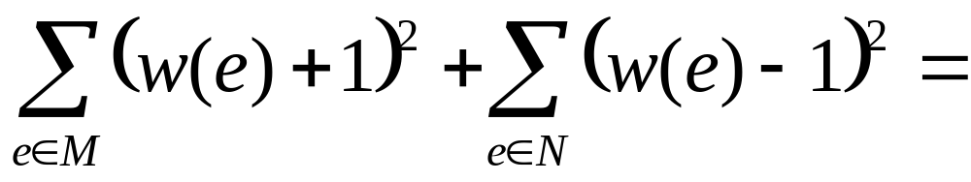
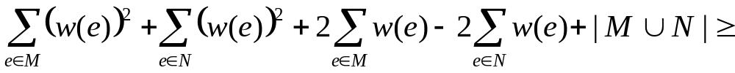
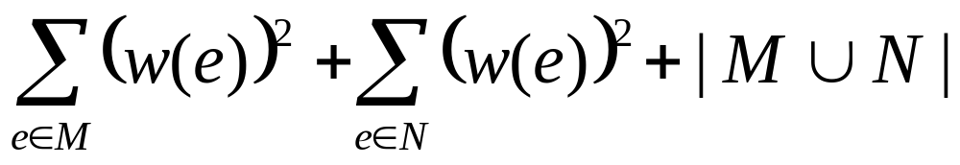
Sum of squares increases by |C|

Slide 29
Edge coloring and classroom schedules
Teachers
Class
Some teachers should teach some classes but:
  No teacher more than one class at a time
  No class more than one lesson at the time
  How many hours needed???
 | Jansen | Petersen | Klaassen
1b | X
2a |  |  | X
2b |  | X

Slide 30
 | Jansen | Petersen | Klaassen
1b | X | 1-2 | 2-3
2a | 1-2 | 2-3 | X
2b | 2-3 | X | 1-2

Slide 31
Edge coloring model
Take bipartite graph with vertices for teachers and for classes
Look for a coloring of the edges such that no vertex has two incident edges with the same color.
What is the minimum number of colors needed?
  Lower bound: minimum degree. (Interpretation!)
  We can attain the lower bound with help of matchings!!

Slide 32
A theorem
Let G be a bipartite graph with maximum degree d. Then G has an edge coloring with d colors.
  Step 1: Make G regular by adding vertices and edges.
  Step 2: Repeatedly find a matching and remove it.

Slide 33
Making G regular
Suppose G has vertex sets V₁ and V₂ with edges only between V₁ and V₂. (Usually called: color classes).
If |V₁| > |V₂| then add |V₁| - |V₂| isolated vertices to |V₂| .
If |V₂| > |V₁| then add |V₂| - |V₁| isolated vertices to |V₁| .
While not every vertex in V₁ ∪ V₂ has degree d:
  Find a vertex v in V₁ of degree less than d
  Find a vertex w in V₂ of degree less than d
  Add the edge {v,w} to the graph.
Must
exist
Notes:
One of the two v, and w exist by assumption. The other one you can see by counting edges.

Slide 34
Edge coloring a regular graph
Say G’ is regular of degree d.
For i = 1 to d do
  Find a perfect matching M in G’.
  Give all edges in M color i.
  Remove all edges in M from G’. (Note that G’ stays regular!)

Slide 35
Final step
Take the edge coloring c of G’. Color G in the same way: G is subgraph of G.
Time: carrying out d times a perfect matching algorithm in a regular graph:
  O(nd³) if we use Schrijver’s algorithm.
  Can be done faster by other algorithms.

Slide 36
Trivial drawing strategies in multidimensional tictactoe
Tic-tac-toe
Generalisations
  More dimensions
  Larger board size
Who has a winning strategy?
  Either first player has winning strategy, or second player has drawing strategy

Slide 37
Trivial drawing strategy
If lines are long enough: pairing of squares such that each line has a pair
If player 1 plays in a pair, then player 2 plays to other square in pair
v | i | a | a | f
j | b | h | u | b
c | i |  | g | c
d | u | h | d | f
j | e | e | g | v

Slide 38
Trivial drawing strategies and generalized matchings
Bipartite graph: line-vertices and square-vertices; edge when square is part of line
Look for set of edges M, such that:
  Each line-vertex is incident to two edges in M
  Each square-vertex is incident to at most one edge in M
There exists such a set of edges M, if and only if there is a trivial drawing strategy (of the described type).

Slide 39
Consequences
Testing if trivial drawing strategy exists and finding one if so can be done efficiently (flow algorithm).
n by n by …by n tic-tac-toe (d-dimensional) has a trivial drawing strategy if n is at least 3^{d}-1
  A square belongs to at most 3^{d}-1lines.
  So, if n is at least 3^{d}-1then line-square graph has an edge coloring with n colors.
  Let M be the set of edges with colors 1 and 2.

Slide 40
Conclusion
Many applications of matching! Often bipartite…
Algorithms for finding matchings:
  Bipartite: flow models
  Bipartite, regular: Schrijver
  General: with M-augmenting paths and blossom-shrinking

